Slide 1
MA206
Lesson 24: Conditional Probability

Slide 2
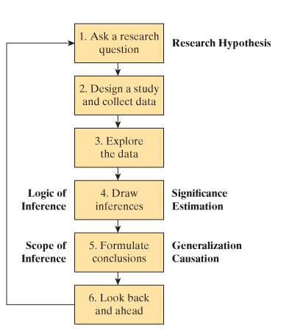
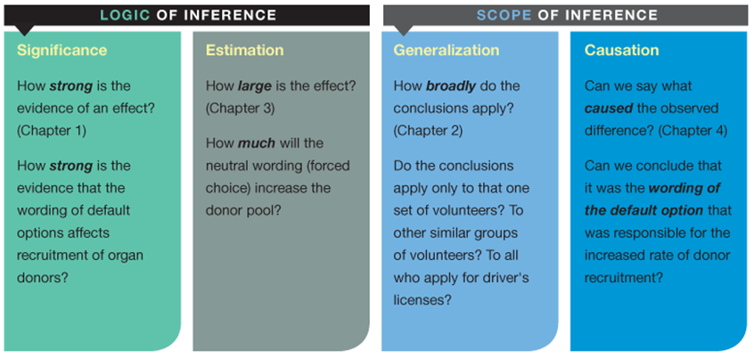
Course Overview
Topics
Single Proportion
Single Quantitative Variable
Causation
Comparing Two Proportions
Comparing Two Means
Two Quantitative Variables
Quantitative Response with multiple explanatory variables
Probability Topics

Slide 3
Warmup
Which regions would you shade for the following questions:
A
B
1
3
2
4

Slide 4
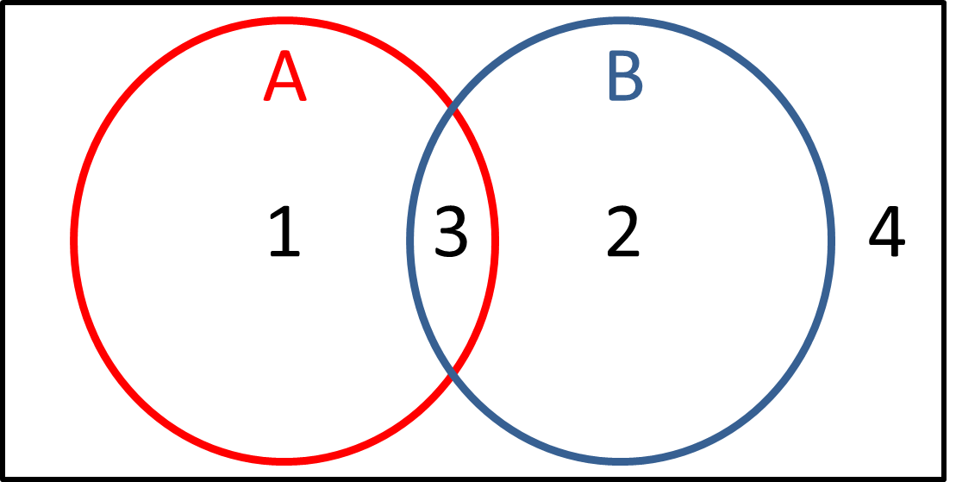

$$P(A)$$
A: 1
B: 1, 2
C: 1, 2, 3
D: 1, 3

Slide 5

$$P(A∩B)$$
A: 1, 2
B: 1, 3, 2
C: 3
D: 4

Slide 6

$$P(A∪B)$$
A: 1, 2
B: 1, 3, 2
C: 3
D: 4

Slide 7

$$P(A∪B^{C})$$
A: 1, 4
B: 1, 3, 4
C: 1
D: 4

Slide 8

Conditional Probability
$P\left(A\right)= ?$
$$= .4+.1= .50$$
$$P\left(B | A\right)= ?$$
Probability that $B$ occurs
given $A$ has occurred
$$P(B|A)= \frac{0.1}{.5}= .20$$
$P\left(B | A\right)= \frac{P(B∩A)}{P(A)} ⇒ P\left(B∩A\right)=P\left(B | A\right)P(A)$
With a conditional probability, your new sample space becomes what you condition on!
A
B
.4
.1
.3
.2
Multiplication Rule

Slide 9
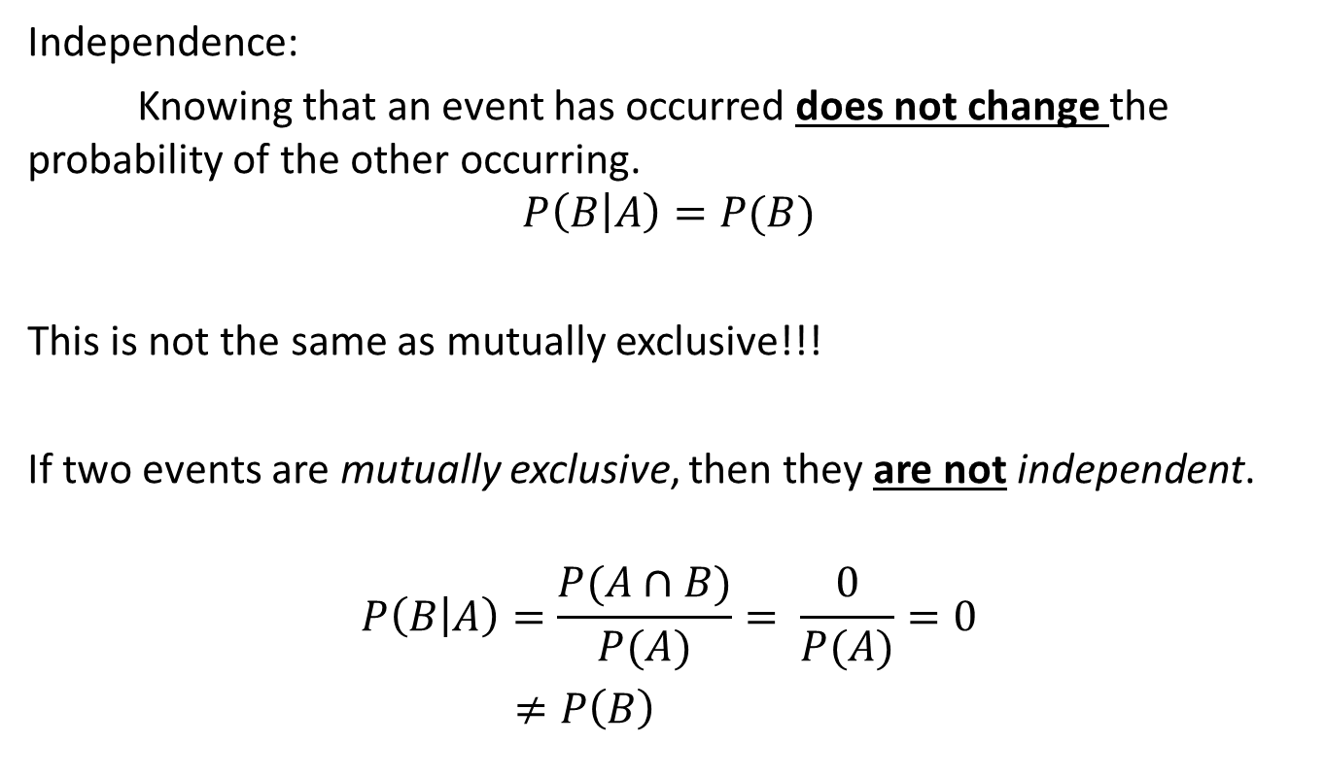
Independence
Independence:
Knowing that an event has occurred does not change the probability of the other occurring.
$$P\left(B | A\right)=P(B)$$
This is not the same as mutually exclusive!!!
If two events are mutually exclusive, then they are not independent.
$$P\left(B | A\right)=\frac{P(A∩B)}{P(A)}= \frac{0}{P(A)}=0$$
$≠P\left(B\right)$

Slide 10

Example
 | Female | Male | Total
No IOCT Tab | 37 | 163 | 200
IOCT Tabbed | 22 | 71 | 93
Total | 59 | 234 | 293
$F:$ Cadet is Female$, T:$ Tabbed IOCT
$$P\left(T\right)=\frac{93}{293}≈0.317$$
$$P\left(T | F\right)= ?$$
$$= \frac{22}{59}≈.373$$
$P\left(T | F\right)≠P\left(T\right)⇒$not independent

Slide 11

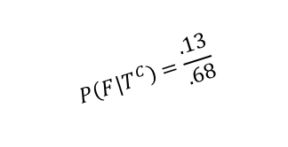
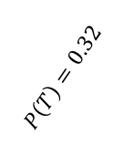


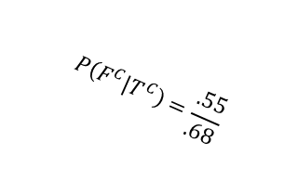
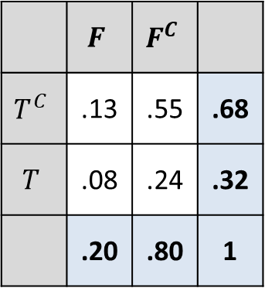


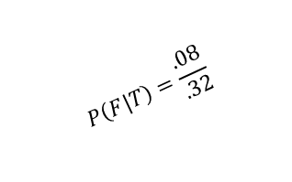
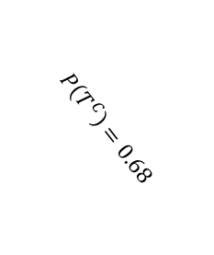
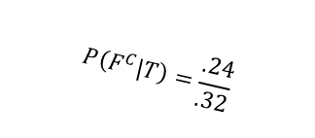




Tree Diagram
Conditional Probability
$$P(T∩F)=.08$$
 | $$F$$ | $$F^{C}$$
$$T^{C}$$ | .13 | .55 | .68
$$T$$ | .08 | .24 | .32
 | .20 | .80 | 1
$$F|T$$
$$P\left(F | T\right)=\frac{.08}{.32}$$
$$F^{c}|T$$
T
$$P\left(F^{C} | T\right)=\frac{.24}{.32}$$
$$P\left(T∩F^{C}\right)=0.24$$
$$P\left(T\right)=0.32$$
$$T^{C}$$
$$P\left(T^{C}∩F\right)= .13$$
$$F|T^{c}$$
$$P\left(T^{C}\right)=0.68$$
$$P\left(F|T^{C}\right)=\frac{.13}{.68}$$
$$F^{c}|T^{c}$$
$$P\left(F^{C}|T^{C}\right)=\frac{.55}{.68}$$
$$P\left(T^{C}∩F^{C}\right)=0.55$$

Slide 12

Conditional Probability
Multiplication Rule
Bayes’ Theorem
Total Probability Rule
Independence
$$P\left(B | A\right)=\frac{P\left(A∩B\right)}{P\left(A\right)}$$
$$P\left(B | A\right)×P\left(A\right)=P\left(A∩B\right)$$
$$P\left(B | A\right)=\frac{P\left(A | B\right)×P\left(B\right)}{P(A)}$$
$$P\left(A\right)=P\left(A∩B_{1}\right)+P\left(A∩B_{2}\right)+ …$$
$=P\left(A | B_{1}\right)P\left(B_{1}\right)+P\left(A | B_{2}\right)P\left(B_{2}\right)+ …$
$$P\left(B | A\right)=P\left(B\right)$$
$$P\left(A∩B\right)=P\left(B\right)×P(A)$$

